Slide 1
SalesGenie AI – AI Sales Assistant & Lead Intelligence Platform

Slide 2
The platform gathers information from websites, CRM systems, emails, social media, and customer interactions to generate actionable insights.
It can automatically score leads, recommend the best prospects, personalize email responses, schedule follow-ups, predict customer buying behavior, and provide real-time sales recommendations.

Slide 3
Key Features
Lead Identification
Lead Scoring
Customer Profiling
Email & Chat Automation
Sales Forecasting
Meeting Scheduling
CRM Integration
Real-Time Analytics

Slide 4
Real-Time Example
Scenario
A software company sells cloud-based accounting software to small businesses.
Step 1: Lead Discovery
The AI platform scans business directories, LinkedIn, company websites, and online forms to identify businesses that may need accounting software.
Example Lead
Company: ABC Traders
Industry: Retail
Employees: 60
Location: Chennai
Annual Revenue: ₹15 Crore

Slide 5
Step 2: Lead Intelligence
The AI analyzes available information and generates insights:
Parameter Result
Company Size Medium
Technology Used Excel-based accounting
Hiring Activity Hiring accountants
Website Visits 6 visits in last week
Email Opens 5 out of 6 emails opened

Slide 6
Step 3: AI Lead Score
The platform calculates the probability of conversion.
Factor Score
Company Fit 25/25
Engagement 30/30
Budget 20/20
Decision Maker Interaction 20/20
Buying Intent 5/5
Final Lead Score = 100/100 (Hot Lead)

Slide 7
Step 4: AI Recommendation
The AI assistant suggests:
Contact the Finance Manager today.
Offer a free 14-day product trial.
Highlight GST compliance and automated invoice generation.
Schedule a live demo within 24 hours.

Slide 8
Step 5: Automated Personalized Email
Subject: Simplify Your Accounting with AI-Powered Software
Dear Mr. Kumar,
I noticed that your company is expanding and may benefit from a modern accounting solution. Our AI-powered platform helps businesses automate GST filing, invoice generation, and financial reporting.
Would you be available for a 20-minute product demonstration this week?
Best Regards,
Sales Team

Slide 9
Step 6: Sales Outcome
Before AI After AI
Manual lead search AI automatically identifies leads
Generic emails Personalized emails
Equal attention to all leads Priority given to high-value leads
Low conversion rate Higher conversion rate
Time-consuming follow-ups Automated reminders and follow-ups

Slide 10
Benefits
Increases sales productivity.
Improves lead conversion rates.
Reduces manual work for sales teams.
Provides data-driven decision-making.
Enhances customer engagement through personalized communication.
Predicts customer buying intent more accurately.
Saves time by automating repetitive sales tasks.

Slide 11
Real-World Examples
Many organizations use AI-powered sales and lead intelligence platforms, including:
Salesforce Einstein AI
HubSpot AI
Zoho Zia
Microsoft Dynamics 365 Sales

Slide 12
Lead Management & Prospect Database - Module 1
Create and manage prospect and customer records.
Store company profiles, contact details, and engagement history.
Track lead lifecycle and sales stages.

Slide 13
Step 1: Lead Registration
A new lead enters the system through various sources such as:
Company website contact form
Social media advertisements
Email campaigns
LinkedIn
Trade shows or exhibitions
Sales representative manual entry
Example
Field Value
Lead ID L001
Company Name ABC Traders
Contact Person Rahul Kumar
Email rahul@abctraders.com
Phone +91-9876543210
Industry Retail
Source Website
Output: A new lead record is created in the prospect database.

Slide 14
Step 2: Company Profile Creation
The AI platform stores detailed company information.
Information Stored
Company name
Industry
Business size
Annual revenue
Location
Number of employees
Website
Products/Services
Example
Company ABC Traders
Industry Retail
Employees 60
Revenue 15 Crore
City Chennai
Website www.abctraders.com
Output: Complete company profile available for future analysis.

Slide 15
Step 3: Contact Management
The platform records all important contacts within the company.
Example
Name Position Email Phone
Rahul Kumar Finance Manager rahul@abctraders.com +91-9876543210
Priya Sharma IT Manager priya@abctraders.com +91-9876543200
Output: Multiple contacts can be linked to one company.

Slide 16
Step 4: Engagement History
Every customer interaction is automatically stored.
Activities Recorded
Phone calls
Emails sent
Emails opened
Website visits
Product demo requests
Meetings
Chatbot conversations
Example
Date Activity Status
10 June Website Visit Completed
11 June Email Sent Delivered
12 June Email Opened Yes
13 June Product Demo Completed
14 June Follow-up Call Pending
Output: Complete interaction history is maintained.

Slide 17
Step 5: AI Lead Analysis
The AI engine analyzes customer behavior using collected data.
AI Checks
Number of website visits
Email open rate
Product pages viewed
Demo requests
Previous purchases
Industry match
Company size
Example
Parameter Result
Website Visits 8
Email Opens 6
Demo Request Yes
Buying Intent High
Output: AI identifies highly interested prospects.

Slide 18
Step 6: Lead Scoring
The AI assigns a score based on the likelihood of conversion.
Example Formula
Lead Score =
Company Fit = 30
Customer Engagement = 30
Budget = 20
Decision Maker Activity = 10
Buying Intent = 10
Total Score = 100
Classification
Score Category
81–100 Hot Lead
61–80 Warm Lead
41–60 Cold Lead
0–40 Low Priority
Output: Sales team focuses first on Hot Leads.

Slide 19
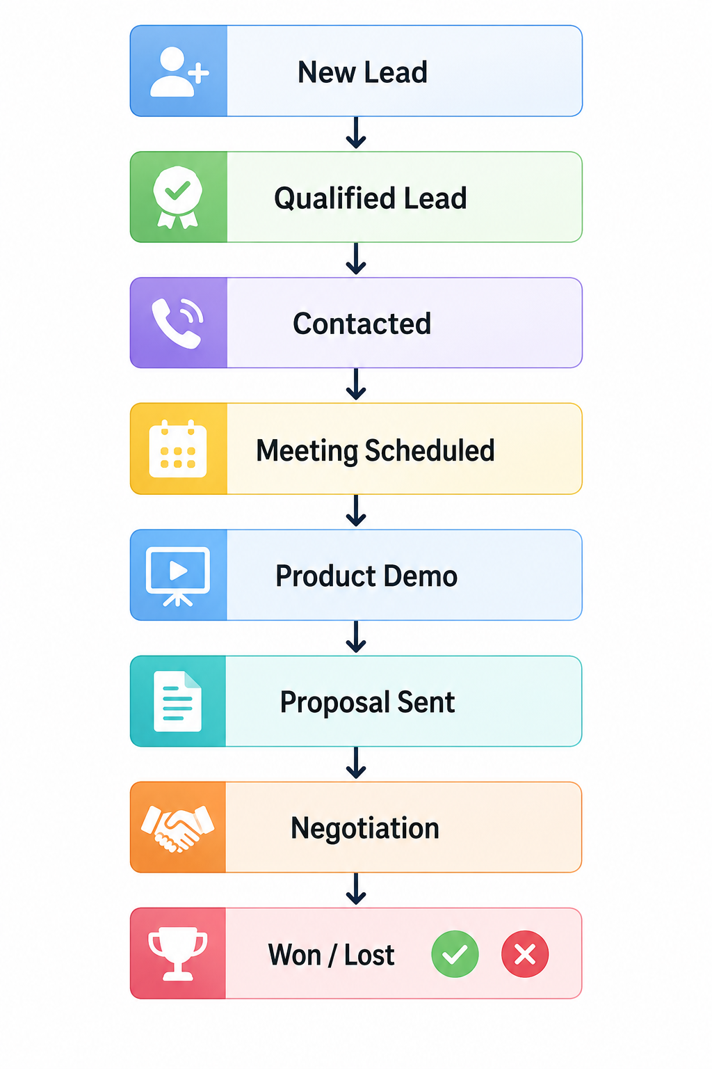
Step 7: Sales Stage Tracking
Each lead moves through predefined sales stages.
Sales Lifecycle

Slide 20
Example
Lead ID Current Stage
L001 Product Demo

Slide 21
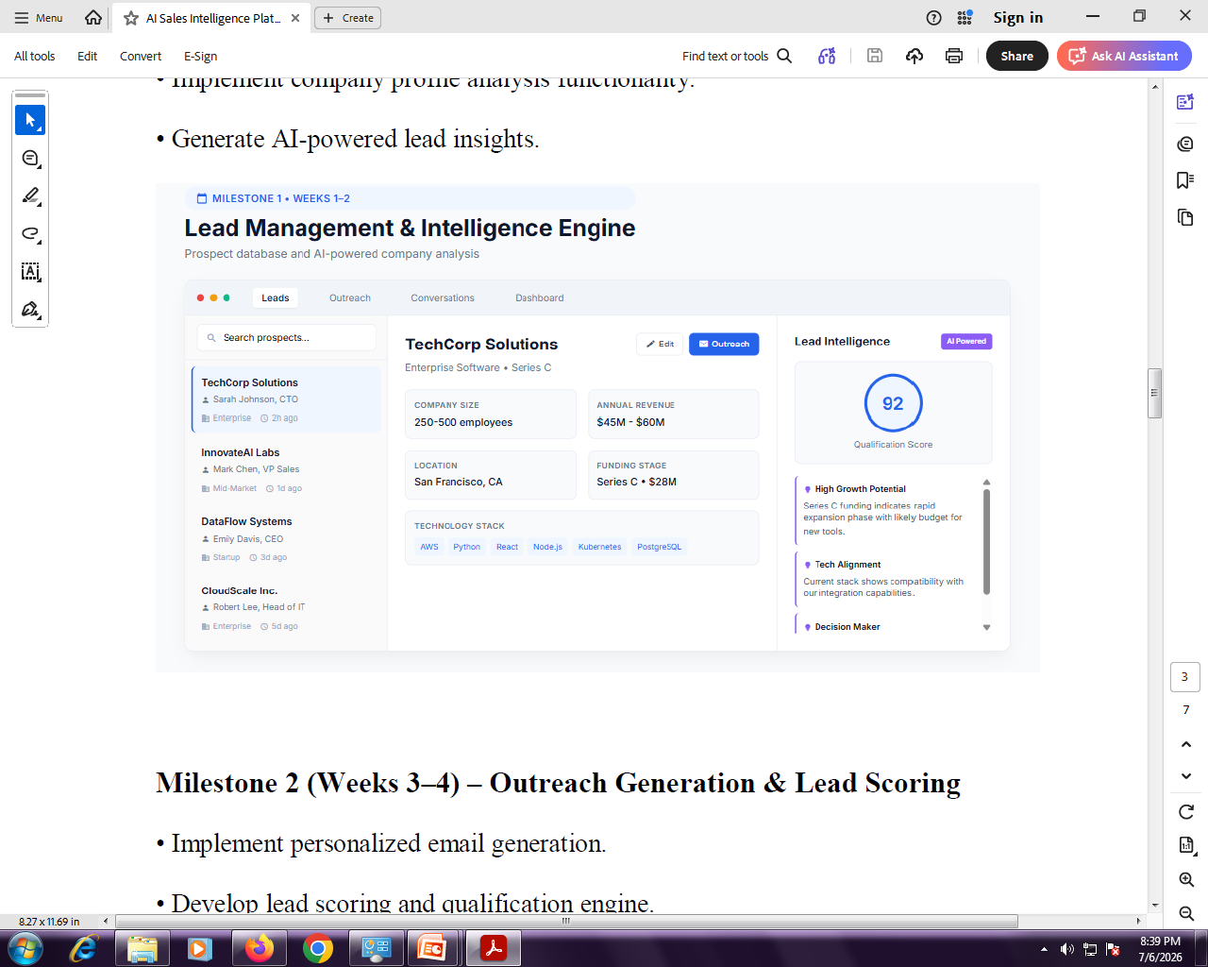

Slide 22
Complete Workflow
New Lead
│
▼
Lead Database
│
▼
Company Details
│
▼
AI Analysis
│
▼
Qualification Score
│
▼
Technology Matching
│
▼
Decision Maker Identification
│
▼
Outreach (Email/LinkedIn)
│
▼
Sales Follow-up
│
▼
Deal Won / Lost

Slide 23
1. Lead List Panel (Left Side)
Purpose: Displays all prospects/customers available in the database.
Features
Search prospects
Company Name
Contact Person
Designation
Business Category
Last Activity
Select a lead to view complete information

Slide 24
Example
Company Name : TechCorp Solutions
Contact Person : Sarah Johnson
Designation : CTO
Category : Enterprise
Last Contact : 2 hours ago

Slide 25
Python Code (Lead List)
class Lead:
def __init__(self, company, contact, designation, category):
self.company = company
self.contact = contact
self.designation = designation
self.category = category
lead1 = Lead(
"TechCorp Solutions",
"Sarah Johnson",
"CTO",
"Enterprise"
)
print("Company :", lead1.company)
print("Contact :", lead1.contact)
print("Designation :", lead1.designation)
print("Category :", lead1.category)

Slide 26
Output
Company : TechCorp Solutions
Contact : Sarah Johnson
Designation : CTO
Category : Enterprise

Slide 27
2. Company Details Panel (Center)
This section stores complete company information.
Information Stored
Company Name
Industry
Company Size
Annual Revenue
Location
Funding Stage
Technology Stack

Slide 28
Example
Company Name : TechCorp Solutions
Industry : Enterprise Software
Company Size : 250-500 Employees
Revenue : $45M-$60M
Location : San Francisco
Funding : Series C
Technology :
AWS
Python
React
Node.js
Kubernetes
PostgreSQL

Slide 29
Python Code
company = {
"Company":"TechCorp Solutions",
"Industry":"Enterprise Software",
"Size":"250-500 Employees",
"Revenue":"$45M-$60M",
"Location":"San Francisco",
"Funding":"Series C",
"Technology":[
"AWS",
"Python",
"React",
"Node.js",
"Kubernetes",
"PostgreSQL"
]
}
for key, value in company.items():
print(key,":",value)

Slide 30
4. Outreach Button
Used to send
Email
LinkedIn Message
WhatsApp
SMS
to the selected lead.
Example
def send_email(name):
print("Email Sent Successfully to", name)
send_email(company["Company"])
Output
Email Sent Successfully to TechCorp Solutions

Slide 31
5. AI Lead Intelligence Panel
This is the AI-powered recommendation engine.
It analyzes
Company profile
Funding
Technology
Company growth
Buying probability
Then generates a Lead Score.
Example
Qualification Score
92/100
Higher score indicates higher probability of closing the deal.

Slide 32
AI Scoring using Machine Learning
from sklearn.tree import DecisionTreeClassifier
X = [
[250,60,28],
[80,10,5],
[400,90,50],
[100,15,8]
]
y = [1,0,1,0]
model = DecisionTreeClassifier()
model.fit(X,y)
prediction = model.predict([[300,55,30]])
print(prediction)
Output
[1]
Meaning
1 = Qualified Lead
0 = Not Qualified

Slide 33
6. AI Recommendations
The system automatically generates intelligent recommendations.
Example
High Growth Potential
Series C Funding
Budget available
Expansion phase
Good target

Slide 34
Python
score = 92
if score > 90:
print("High Growth Potential")
Output
High Growth Potential

Slide 35
7. Technology Alignment
AI checks whether the prospect's technology matches your product.
Example
Python
AWS
React
PostgreSQL
Compatible
Python
company_stack = ["AWS","Python","React"]
our_product = ["Python","AWS"]
match = set(company_stack).intersection(our_product)
print(match)
Output
{'Python', 'AWS'}

Slide 36
8. Decision Maker Identification
The platform identifies the correct person to contact.
Example
Sarah Johnson
CTO
Technical Decision Maker
Python
designation = "CTO"
if designation == "CTO":
print("Technical Decision Maker")
Output
Technical Decision Maker

Slide 37
9. Search Prospect
Users can search companies instantly.
Python
companies = [
"TechCorp Solutions",
"InnovateAI Labs",
"CloudScale Inc"
]
search = "CloudScale"
for company in companies:
if search.lower() in company.lower():
print(company)
Output
CloudScale Inc

Slide 38
Technologies Used
Module Python Technology
User Interface Streamlit / Flask
Backend Python
Database SQLite / MySQL
Machine Learning Scikit-learn
Data Processing Pandas, NumPy
Visualization Matplotlib / Plotly
Email Automation SMTP / SendGrid
AI Lead Scoring Decision Tree, Random
Forest, Logistic Regression
REST APIs Flask API / FastAPI

